Slide 1
Notes:
Instructor notes:
Welcome to the NIEHS COVID-19 Response Training, Protecting Yourself from COVID-19 in the Workplace. This is an awareness level training designed to inform workers about how to protect themselves and co-workers from exposure to the virus. These materials were developed by the National Institute of Environmental Health Science Worker Training Program, National Clearinghouse for Worker Safety & Health Training.
Sign in participants and review the agenda and plan and logistics for the training.

Slide 2
Goal and learning objectives
Goal: Increase health and safety awareness for responders and workers with potential exposure to COVID-19.
Learning objectives: After attending participants will be able to:
Explain basic facts about COVID-19.
Assess the risk of workplace exposure to COVID-19.
Define key steps in worker protection and infection control.
Identify methods to prevent and respond to COVID-19 exposure in the workplace.
Notes:
Instructor notes:
Review goals and learning objectives. Find out who the attendees are. Why they are participating and what they plan to do with the information.
Note that the research is still ongoing, and information may change as the situation unfolds.

Slide 3

Caution
CAUTION!
This presentation by itself is not sufficient training for personnel who have potential for occupational exposure to SARS Coronavirus-2.
Personnel must be trained to their employer’s site-specific policies and procedures. Training must include practice putting on and taking off PPE and respirators and performing decontamination procedures until competency and confidence can be demonstrated.
Notes:
Instructor notes:
In an operations level training, personnel must be trained to their employer’s site-specific policies & procedures. Training also must include practice putting on and taking off personal protective equipment (PPE) including protective clothing and respirators and performing decontamination procedures until personnel demonstrate competency and confidence.
Trainers should modify or adapt this PPT to meet the needs of trainees. For example, paramedics and EMTs will have different training needs than an environmental services contractor.
It is strongly preferred that the trainees use the actual procedures and equipment they will use on the job.
It is also strongly advised that training be based on the policies and procedures specific to the industry, employer, and job tasks.

Slide 4
Employer and worker responsibilities
Employers and workers have responsibilities under the OSH Act.
• The Occupational Safety and Health Act requires that employers provide a safe and healthy workplace free of recognized hazards and follow OSHA standards. Employers’ responsibilities also include providing training, medical examinations and recordkeeping.
• Workers should participate in the development and implementation of the employer’s safety and health policies and help ensure that they are appropriate and implemented. This includes promoting the use of all required gear and equipment; following safe work practices and reporting hazardous conditions. Workers have a right to report hazardous conditions to OSHA if employers do not fix them.
Notes:
Instructor notes:
Although there is no OSHA rule that deals specifically with the coronavirus, there are OSHA standards that cover several safety and health issues addressed in this booklet. Many of these OSHA standards, such as for respirators or hazard communication, include training requirements for workers. See Module 3 for some of those standards.

Slide 5
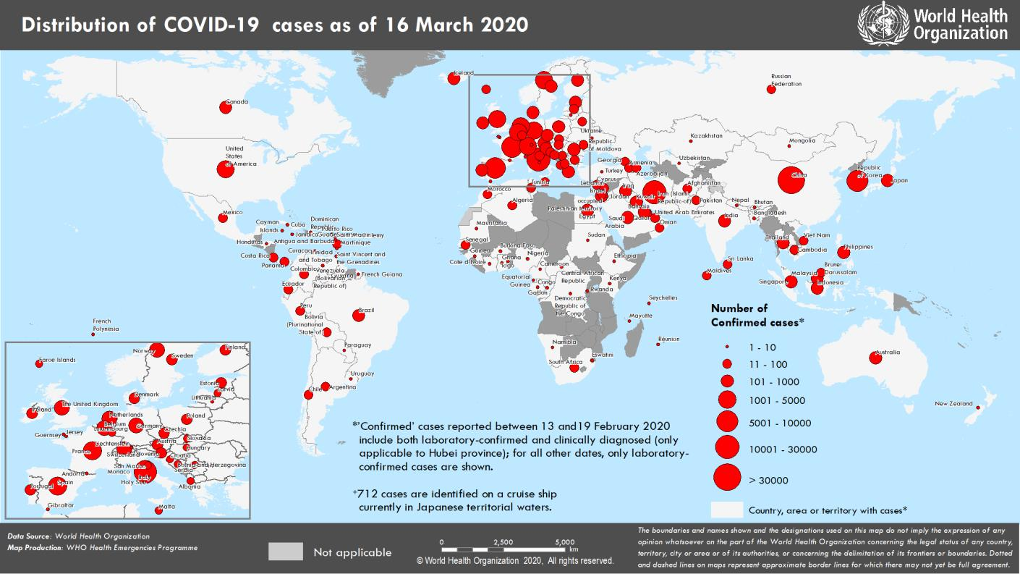
Worldwide distribution map
For current data see: https://experience.arcgis.com/experience/685d0ace521648f8a5beeeee1b9125cd
Notes:
Instructor notes:
Click on the link to access the latest map from WHO: https://experience.arcgis.com/experience/685d0ace521648f8a5beeeee1b9125cd
The information is limited to reported cases that have tested positive. Therefore, cases with low level or no symptoms are excluded from this map.
January 30, 2020, the International Health Regulations Emergency Committee of the World Health Organization declared the outbreak a “public health emergency of international concern” https://www.who.int/news-room/detail/30-01-2020-statement-on-the-second-meeting-of-the-international-health-regulations-%282005%29-emergency-committee-regarding-the-outbreak-of-novel-coronavirus-%282019-ncov%29
On January 31, 2020, Health and Human Services Secretary Alex M. Azar II declared a public health emergency (PHE) for the United States to aid the nation’s healthcare community in responding to COVID-19.
According to the World Health Organization, as of March 9, 2020, there are more than 100,000 confirmed cases globally, reported in 102 countries/territories/areas. The countries with the highest number of cases include China (80,859), Korea (7,134), Italy (5,883), and Iran (5,823)
On March 11, 2020 WHO characterized COVID-19 as a pandemic.
The WHO provides up to date information on the coronavirus: https://www.who.int/emergencies/diseases/novel-coronavirus-2019

Slide 6
How widespread could it get?
On March 11, 2020, the World Health Organization (WHO) characterized COVID-19 as a pandemic.
It has caused severe illness and death. It features sustained person-to-person spread worldwide.
Poses an especially high risk for the elderly (60 or older), people with preexisting health conditions such as high blood pressure, heart disease, lung disease, diabetes, autoimmune disorders, and certain workers.
Some models predict 70 to 150 million people in the US could be infected during the pandemic.
Notes:
Instructor notes:
WHO, WHO Director-General’s opening remarks at the media briefing on COVID-19 – 11 March 2020
https://www.who.int/dg/speeches/detail/who-director-general-s-opening-remarks-at-the-media-briefing-on-covid-19---11-march-2020
Source for potential cases: https://www.nytimes.com/2020/03/13/us/coronavirus-deaths-estimate.html
Detail on occupational exposure will come later.

Slide 7
US situation as of March 2020
Experts are predicting that it will spread exponentially as it has in other countries.
Those with elevated risk of exposure include:
Close contacts of persons with COVID-19.
Healthcare workers caring for patients with COVID-19.
Travelers returning from international locations where community spread is occurring.
The entire country is practicing social distancing leading to massive shut down of schools, agencies, and employment.
Notes:
Instructor notes:
According to CDC, different parts of the country are seeing different levels of COVID-19 activity. The United States nationally is currently (Mid March 2020) in the initiation phases, but states where community spread is occurring are in the acceleration phase. The duration and severity of each phase can vary depending on the characteristics of the virus and the public health response. For updates visit: https://www.cdc.gov/coronavirus/2019-ncov/cases-updates/summary.html

Slide 8
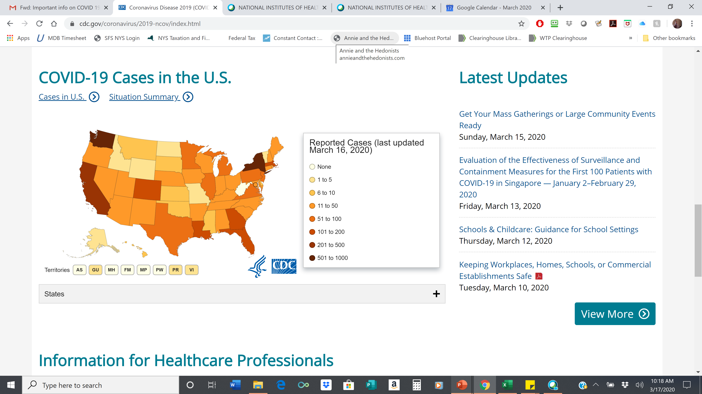
US distribution map as of 3/16/2020
For updates see: https://www.cdc.gov/coronavirus/2019-ncov/cases-in-us.html#2019coronavirus-summary
Notes:
Instructor notes:
For updates go to CDC website: https://www.cdc.gov/coronavirus/2019-ncov/cases-in-us.html#2019coronavirus-summary
Note that the number of reported cases is significantly underreported because of the lack of testing. The numbers reflect the more severe cases that have required a visit to the emergency department or hospitalization. Also, people with low level symptoms are unlikely to report their illness.

Slide 9
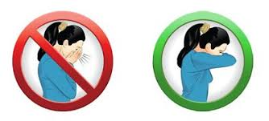
What can individuals do?
Be informed and prepared.
Wash your hands frequently.
Use alcohol-based hand sanitizer.
Avoid touching your eyes, nose, and mouth with unwashed hands.
Stay home when you are sick.
Cough or sneeze into a tissue or your elbow.
Clean and disinfect frequently touched objects and surfaces such as cell phones.
Be prepared if your child’s school, daycare facility, or your worksite is temporarily closed.
Notes:
Instructor notes:
There are steps that workers and the rest of the general population can take to combat COVID-19:
Become and stay informed about the coronavirus and what can be done to reduce the chances of becoming infected. This booklet is intended to help workers understand what can be done in their workplaces to protect themselves. Other sources of information, including government websites and publications are aimed at the entire population.
Prepare by following the recommendations contained in this document and elsewhere.
The current situation is fluid. Information and public health officials’ guidance are subject to change, sometimes quite suddenly. There are many factors that could develop which would require a revised strategy. Some of these developments could include:
- SARS CoV-2 increases in virulence, causing more death and serious illness.
- SARS CoV-2 becomes resistant to any newly established treatments.
- Prevention measures such as respirators are not available and/or effective.

Slide 10

Five steps to proper handwashing
Wet your hands with clean, running water (warm or cold), turn off the tap, and apply soap.
Lather your hands by rubbing them together with the soap. Lather the backs of your hands, between your fingers, and under your nails.
Scrub your hands for at least 20 seconds. Need a timer? Hum the “Happy Birthday” song from beginning to end twice.
Rinse your hands well under clean, running water.
Dry your hands using a clean towel or air dry them.
Notes:
Instructor notes:
CDC: When and How to Wash Your Hands, https://www.cdc.gov/handwashing/when-how-handwashing.html
Activity: Ask the participants if anyone is having a birthday today? Then ask the participants to dry wash their hands while singing happy birthday twice to that participant.

Slide 11
Precautionary principle
When it comes to worker safety, we should be driven by the ‘precautionary principle’ that reasonable steps to reduce risk should not await scientific certainty about the nature of the hazard or risk.
Notes:
Instructor notes:
There is much that is not known about COVID-19. What is true today could change in the coming months. However, that does not mean that reasonable and effective steps cannot or should not be taken now to prepare and to protect workers. Erring on the side of caution will prevent illnesses and deaths.
The precautionary principle should guide our planning and actions: When it comes to worker safety, we should be driven by the ‘precautionary principle’ that reasonable steps to reduce risk should not await scientific certainty about the nature of the hazard or risk.

Slide 12

Module 1: COVID-19 Basics
Notes:
Instructor notes:
Because SARS CoV-2 is a new virus, information is changing on almost a daily basis. It is very important to check authoritative sources of information to make sure the training material is current. This includes primary sources like CDC, OSHA, NAID, and peer reviewed journals such as JAMA, NEJM, etc.

Slide 13
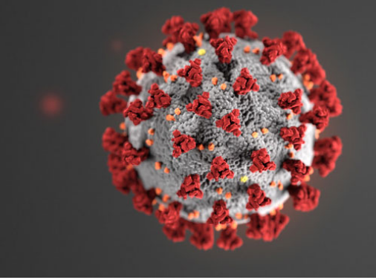
What is SARS-CoV-2?
SARS-CoV-2 is the virus that causes coronavirus disease 2019 (COVID-19)
SARS = severe acute respiratory distress syndrome
Spreads easily person-to-person particularly when someone sneezes
Little if any immunity in humans
Detailed information: https://www.cdc.gov/coronavirus/2019-ncov/index.html
Notes:
Instructor notes:
The virus has been named “SARS-CoV-2” and the disease it causes has been named “coronavirus disease 2019” (abbreviated “COVID-19”). Throughout this training we refer to the virus as SARS CoV-2 and the disease as COVID-19.
Coronaviruses are a large family of viruses that are common in people and many different species of animals, including camels, cattle, cats, and bats. Rarely, animal coronaviruses can infect people and then spread between people such as with MERS-CoV, SARS-CoV, and now with this new virus (named SARS-CoV-2).
The SARS-CoV-2 virus is a betacoronavirus, like MERS-CoV and SARS-CoV. All three of these viruses have their origins in bats. The sequences from U.S. patients are similar to the one that China initially posted, suggesting a likely single, recent emergence of this virus from an animal reservoir. (https://www.cdc.gov/coronavirus/2019-nCoV/summary.html)
The SARS CoV-2 virus is a novel strain, meaning that it is new. As a result, humans have not developed immunity to COVID-19, and therefore can be infected. Acquired immunity is when humans have been exposed or vaccinated previously to an infectious agent. An example is when people have measles in childhood or are vaccinated, they develop antibodies and a certain level of protection.
Early on, many of the patients at the epicenter of the outbreak in Wuhan, Hubei Province, China had some link to a large seafood and live animal market, suggesting animal-to-person spread. Later, a growing number of patients reportedly did not have exposure to animal markets, indicating person-to-person spread. Person-to-person spread was subsequently reported outside Hubei and in countries outside China, including in the United States. Some international destinations now have apparent community spread with the virus that causes COVID-19, as do some parts of the United States. Community spread means some people have been infected and it is not known how or where they became exposed.

Slide 14
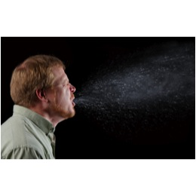
Transmission
COVID-19 is spread from person to person mainly through coughing, sneezing, and possibly talking, and breathing.
Droplet - respiratory secretions from coughing or sneezing landing on mucosal surfaces (nose, mouth, and eyes)
Aerosol - a solid particle or liquid droplet suspended in air
Contact -Touching something with SARS-2 virus on it and then touching mouth, nose or eyes
Other possible routes: Through fecal matter
Notes:
Instructor notes:
Spread of SARS-CoV-2, the virus that causes COVID-19, is thought to occur in the same way that seasonal flu spreads. Flu viruses are spread mainly from person to person through coughing or sneezing by people with influenza. We will not fully know how it is transmitted until later when scientists have had time to evaluate it.
Droplet transmission occurs when respiratory secretions from coughing or sneezing land on mucosal surfaces (nose, mouth, and eyes).
Contact transmission is touching something with COVID-19 virus on it and then touching your mouth, nose or eyes.
Aerosol transmission means breathing in infectious COVID-19 particles.
Keep in mind that the virus particles are not visible to the naked eye. The most harmful particles are sub micron, shorter than one millionth of a meter.
It is not likely that SARS CoV-2 is airborne.

Slide 15
Incubation period
The incubation period is the time between exposure to a virus and the onset of symptoms.
With COVID- 19 symptoms may show 2-14 days after exposure.
People are most contagious when they are the most symptomatic.
Scientific uncertainties:
People who are infected may be contagious before they develop symptoms or even if they never develop symptoms.
Notes:
Instructor notes:
Most estimates of the incubation period for COVID-19 range from 1-14 days, most commonly around five days. The “incubation period” means the time between catching the virus and beginning to have symptoms of the disease.
This can be longer in some people, especially children and people with weakened immune systems and in people infected with the new COVID-19 virus.
A Johns Hopkins study estimated the median incubation period at 5.1 days ((95% confidence interval [CI], 4.5 to 5.8 days). They found that 97.5% of patients who have symptoms do so within 11.5 days of infection (CI, 8.2 to 15.6 days). https://annals.org/aim/fullarticle/2762808/incubation-period-coronavirus-disease-2019-covid-19-from-publicly-reported
Can someone spread the virus without being sick?
People are thought to be most contagious when they are most symptomatic (the sickest).
Some spread might be possible before people show symptoms; there have been reports of this occurring with this new coronavirus, but this is not thought to be the main way the virus spreads.
CDC: https://www.cdc.gov/coronavirus/2019-ncov/about/transmission.html
Article in medRxiv :
COVID-19 can be spread before it causes symptoms, when it produces symptoms like those of the common cold, and as many as 12 days after recovery, according to a virologic analysis of nine infected patients published on the preprint server medRxiv. https://www.medrxiv.org/content/10.1101/2020.03.07.20032052v1
Led by researchers in Germany, the virologic study, which has not yet been peer-reviewed, found that the novel coronavirus quickly begins producing high viral loads, sheds efficiently, and grows well in the upper respiratory tract (nose, mouth, nasal cavity, and throat).
https://www.medrxiv.org/content/10.1101/2020.03.05.20030502v1.full.pdf
http://www.cidrap.umn.edu/news-perspective/2020/03/study-highlights-ease-spread-covid-19-viruses
Article in JAMA: Air, Surface Environmental, and Personal Protective Equipment Contamination by Severe Acute Respiratory Syndrome Coronavirus 2 (SARS-CoV-2) From a Symptomatic Patient
Citation: Ong SWX, Tan YK, Chia PY, et al. Air, Surface Environmental, and Personal Protective Equipment Contamination by Severe Acute Respiratory Syndrome Coronavirus 2 (SARS-CoV-2) From a Symptomatic Patient. JAMA. Published online March 04, 2020. doi:10.1001/jama.2020.3227

Slide 16
COVID-19 can cause mild to severe symptoms
Most common symptoms include:
Fever
Cough
Shortness of breath
Other symptoms may include:
Sore throat
Runny or stuffy nose
Body aches
Headache
Chills
Fatigue
Notes:
Instructor notes:
The symptoms may appear 2-14 days after exposure.
Reports from China have documented that most people experience a mild illness when infected with SARS CoV-2. However, the same report documented that 16% of the cases had severe illness and about 2.5% resulted in death.
Clinical Characteristics of Coronavirus Disease 2019 in China, NEJM, February 28, 2020 https://www.nejm.org/doi/pdf/10.1056/NEJMoa2002032?articleTools=true

Slide 17
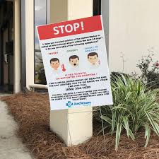
Severe symptoms –emergency warning signs for COVID-19
Most people will have mild symptoms and should recover at home and NOT go to the hospital or emergency room.
Get medical attention immediately if you have:
Difficulty breathing or shortness of breath.
Persistent pain or pressure in the chest.
New confusion or inability to arouse.
Bluish lips or face.
Notes:
Instructor notes:
Source: https://www.cdc.gov/coronavirus/2019-ncov/symptoms-testing/symptoms.html
This list of severe symptoms is not all inclusive. Please consult your medical provider for any other symptoms that are severe or concerning.
The reason to stay away from emergency rooms, hospitals, and family doctors is to avoid spreading SARS CoV-2 to others. For most healthy people the illness will be mild, and you can recover at home by drinking lots of fluids and use of over the counter medications. You should also separate yourself from other people at home and practice good personal and environmental hygiene.

Slide 18
What is a person under investigation?
A person who has both consistent signs or symptoms and risk factors as follows:
Symptoms, including cough, fever, and shortness of breath
A potential exposure within 14 days before the onset of symptoms.
Suspect Case
Notes:
Instructor notes:
The CDC uses the term Person Under Investigation (PUI) for a suspect case.
A suspect caser or PUI is a person who has both consistent symptoms and risk factors as follows:
Clinical criteria, which includes cough, fever, and shortness of breath; AND
risk factors within the past 14 days before the onset of symptoms, such as contact patient known to have or suspected to have COVID-19; residence in—or travel to—an area where COVID-19 transmission is active; or direct handling of bats or non-human primates from disease areas.
https://www.cdc.gov/coronavirus/2019-ncov/php/guidance-evaluating-pui.html
https://www.cdc.gov/coronavirus/2019-ncov/php/reporting-pui.html

Slide 19

Confirmed case
A confirmed case is a suspect case with laboratory-confirmed diagnostic evidence of SARS CoV-2 virus infection.
U.S. Centers for Disease Control and Prevention via AP
Notes:
Instructor notes:
CDC has developed a new laboratory test kit for use in testing patient specimens for severe acute respiratory syndrome coronavirus 2 (SARS-CoV-2), the virus that causes COVID-19. The test kit is called the “Centers for Disease Control and Prevention (CDC) 2019-Novel Coronavirus (2019-nCoV) Real-Time Reverse Transcriptase (RT)-PCR Diagnostic Panel.”
Because testing is not widely available, it is likely that there are many cases that have not been confirmed.
https://www.cdc.gov/coronavirus/2019-ncov/about/testing.html

Slide 20
How long does SARS-CoV-2 survive outside of the body?
It is not clear yet how long the coronavirus can live on surfaces, but it seems to behave like other coronaviruses.
Virus may persist on surfaces for a few hours or up to several days, depending on conditions and the type of surface.
It is likely that it can be killed with simple disinfectant on the EPA registered list below.
https://www.epa.gov/pesticide-registration/list-n-disinfectants-use-against-sars-cov-2
There are ongoing investigations to learn more.
Notes:
Instructor notes:
It is not certain how long the virus that causes COVID-19 survives on surfaces, but it seems to behave like other coronaviruses. Studies suggest that coronaviruses, including preliminary information on the SARS CoV-2 virus, may persist on surfaces for a few hours or up to several days. This may vary under different conditions such as type of surface, temperature, and humidity of the environment. If you think a surface may be infected, clean it with simple disinfectant to kill the virus and protect yourself and others. Clean your hands with an alcohol-based hand rub or wash them with soap and water. Avoid touching your eyes, mouth, or nose.
Contact time is very important. This is the amount of time that the surface should remain wet with the product. All of the EPA listed products have a 10 minute contact time, except Hydrogen Peroxide; Peroxyacetic Acid has a 1 minute contact time. Many of these chemicals have caused negative health effects such as occupational asthma and dermatitis. It is important that proper safeguards are in place to prevent harm to people doing the cleaning and disinfecting.
The EPA list of registered disinfectants includes 200 products that have qualified for use against SARS-CoV-2. While disinfectant products on this list have not been tested specifically against SARS-CoV-2, they are expected to be effective against SARS-CoV-2 because they have been tested and proven effective on either a harder-to-kill virus or against another human coronavirus similar to SARS-CoV-2. The product list has also been updated to include the product’s active ingredient and the amount of time the surface should remain wet to be effective against the given pathogen.
EPA website: https://www.epa.gov/pesticide-registration/list-n-disinfectants-use-against-sars-cov-2
We have heard reports that it is difficult to find some of these products in local stores as their has been a rush of purchasing of them by the public.
https://www.who.int/news-room/q-a-detail/q-a-coronaviruses#
Air, Surface Environmental, and Personal Protective Equipment Contamination by Severe Acute Respiratory Syndrome Coronavirus 2 (SARS-CoV-2) From a Symptomatic Patient
https://jamanetwork.com/journals/jama/fullarticle/2762692
Persistence of coronaviruses on inanimate surfaces and their inactivation with biocidal agents
Human coronaviruses can remain infectious on inanimate surfaces for up to 9 days. Surface disinfection with 0.1% sodium hypochlorite or 62–71% ethanol significantly reduces coronavirus infectivity on surfaces within 1 min exposure time. We expect a similar effect against the SARS-CoV-2.
https://www.journalofhospitalinfection.com/article/S0195-6701(20)30046-3/fulltext
Fomite—An object, such as clothing, towels, and utensils that possibly harbor an infectious agent and are capable of transmitting it.

Slide 21
Increased risk of severe illness
COVID-19 poses a greater risk for severe illness for people with underlying health conditions:
Heart disease
Lung disease such as asthma
Diabetes
Suppressed immune systems
The elderly have higher rates of severe illness from COVID-19. Children and younger adults have had less severe illness and death. Because COVID-19 is new there are a lot of scientific unknowns such as the impact on pregnant women and their fetuses.
Notes:
Instructor notes:
As is the case with seasonal flu, certain conditions appear to put some individuals at increased risk of complications associated with COVID-19. These underlying conditions are listed above.
https://www.cdc.gov/coronavirus/2019-ncov/specific-groups/high-risk-complications.html
Early information out of China, where COVID-19 first started, shows that some people are at higher risk of getting very sick from this illness. This includes:
Older adults
People who have serious chronic medical conditions like:
Heart disease
Diabetes
Lung disease
If a COVID-19 outbreak happens in your community, it could last for a long time. (An outbreak is when a large number of people suddenly get sick.) Depending on how severe the outbreak is, public health officials may recommend community actions to reduce people’s risk of being exposed to COVID-19. These actions can slow the spread and reduce the impact of disease.
If you are at higher risk for serious illness from COVID-19 because of your age or because you have a serious long-term health problem, it is extra important for you to take actions to reduce your risk of getting sick with the disease.
NOTE: The rates of infection may be biased higher for older people because we more easily identify infections with severe illness.

Slide 22
Comparison SARS 1, MERS, SARS 2 (3/16/2020)
 | SARS 1, 7/5/2003 | MERS, ongoing | SARS 2, ongoing
# of cases | 8,422 | 2,494 | 196,106
Deaths | 916 | 858 | 7,869
Countries impacted | 29 | 27 | 148
Case Fatality Rate | 9.6% | 34.4% | 2.6% estimated
Healthcare Workers | 1,769 (21%) and 5 deaths | 415, and 16% deaths | 1,716 cases and 5 deaths
Note that the numbers in SARS 2 column are changing rapidly. For the latest statistics see: https://coronavirus.jhu.edu/map.html
Notes:
Instructor notes:
Johns Hopkins University & Medicine, Coronavirus Research Center, https://coronavirus.jhu.edu/map.html
WHO Coronavirus disease 2019 (COVID-19) Situation Report – 46 https://www.who.int/docs/default-source/coronaviruse/situation-reports/20200306-sitrep-46-covid-19.pdf?sfvrsn=96b04adf_2
Zunyou Wu, Jennifer M. McGoogan, Characteristics of and Important Lessons from the Coronavirus disease 2019 (COVID-19) Outbreak in China. Summary of a Report of 72 314 Cases from the Chinese Center for Disease Control and Prevention, JAMA, , 2/24/20, https://jamanetwork.com/journals/jama/fullarticle/2762130
OCCUPATIONAL HEALTH ASPECTS OF EMERGING INFECTIONS – SARS OUTBREAK AFFECTING HEALTHCARE WORKERS David Koh, Bandar Seri Begawan, Brunei Darussalam; Occup Environ Med 2018;75(Suppl 2):A1–A650
Occup Environ Med: first published as 10.1136/oemed-2018-ICOHabstracts.40 on 24 April 2018. Downloaded from http://oem.bmj.com/ on March 12, 2020 by guest.

Slide 23

Seasonal Flu vs. COVID-19
COVID-19 has the potential to cause more deaths and hospitalizations
SARS-CoV-2 is much more infectious and spreads faster than the seasonal flu
Notes:
Instructor notes:
COVID-19 and the seasonal flu share similar symptoms, but the coronavirus is a unique virus with unique characteristics.
How are SARS CoV-2 and influenza viruses similar?
Firstly, SARS CoV-2 and influenza viruses have a similar disease presentation. That is, they both cause respiratory disease, which presents as a wide range of illness from a symptomatic or mild through to severe disease and death.
Secondly, both viruses are transmitted by contact, droplets and fomites. As a result, the same public health measures, such as hand hygiene and good respiratory etiquette (coughing into your elbow or into a tissue and immediately disposing of the tissue), are important actions all can take to prevent infection.
https://www.who.int/docs/default-source/coronaviruse/situation-reports/20200306-sitrep-46-covid-19.pdf?sfvrsn=96b04adf_2

Slide 24
Seasonal Flu vs. COVID-19
So far the case fatality rate (CFR) of COVID-19 is estimated to be at around 2%. The CFR of seasonal influenza is estimated to be around 0.1%, making SARS-CoV-2 about 20 times more deadly than the seasonal flu.
An estimated 15 – 20% of infected individuals may suffer from severe symptoms that require medical attention including pneumonia with shortness of breath and lowered blood oxygen saturation.
No Treatment, No Vaccine, No Immunity
Notes:
Instructor notes:
Note that information is changing rapidly and so it is likely these numbers will change as well. Check for updates.
Case fatality rate is defined as the percentage of people who are infected who die from the infection. There have been a range of estimates of the CFR. We won’t know the precise CFR for some time because the number of actual infected people, which is the denominator in the calculation, is unknown at this time.
How are SARS CoV-2 and influenza viruses different?
The speed of transmission is an important point of difference between the two viruses. Influenza has a shorter median incubation period (the time from infection to appearance of symptoms) and a shorter serial interval (the time between successive cases) than SARS CoV-2. The serial interval for SARS CoV-2 is estimated to be 5-6 days, while for influenza virus, the serial interval is 3 days. This means that influenza can spread faster than SARS CoV-2 .
Further, transmission in the first 3-5 days of illness, or potentially pre-symptomatic transmission –transmission of the virus before the appearance of symptoms –is a major driver of transmission for influenza. While we suspect people can shed SARS CoV-2 twenty-four to 48 hours prior to symptom onset, we don’t yet know the importance this is in transmission of the virus.
The reproductive number –the number of secondary infections generated from one infected individual –is understood to be between 2 and 2.5 for SARS CoV-2 , higher than for influenza. However, estimates for both SARS CoV-2 and influenza viruses are very context and time-specific, making direct comparisons more difficult.
Children are important drivers of influenza virus transmission in the community. For SARS CoV-2 , initial data indicates that children are less affected than adults and that clinical attack rates in the 0-19 age group are low. Further preliminary data from household transmission studies in China suggest that children are infected from adults, rather than vice versa.
While the range of symptoms for the two viruses is similar, the fraction with severe disease appears to be different. For SARS CoV-2, data to date suggest that 80% of infections are mild or asymptomatic, 15% are severe infection, requiring oxygen and 5% are critical infections, requiring ventilation. These fractions of severe and critical infection would be higher than what is observed for influenza infection.
Those most at risk for severe influenza infection are children, pregnant women, elderly, those with underlying chronic medical conditions and those who are immunosuppressed. For COVID-19, our current understanding is that older age and underlying conditions increase the risk for severe infection.
Mortality for COVID-19 appears higher than for influenza, especially seasonal influenza. While the true mortality of COVID-19 will take some time to fully understand, the data we have so far indicate that the crude mortality ratio (the number of reported deaths divided by the reported cases) is between 3-4%, the infection mortality rate (the number of reported deaths divided by the number of infections) will be lower. For seasonal influenza, mortality is usually well below 0.1%. However, mortality is to a large extent determined by access to and quality of health care.
https://www.who.int/docs/default-source/coronaviruse/situation-reports/20200306-sitrep-46-covid-19.pdf?sfvrsn=96b04adf_2
Source: Similarity in Case Fatality Rates (CFR) of COVID-19/SARS-COV-2 in Italy and China, Journal of Infectious Diseases in Developing Countries, Vol 14, No.02, February 2020, https://jidc.org/index.php/journal/article/view/32146445
Study of 72,000 COVID-19 patients finds 2.3% death rate, CIDRAP, Stephanie Soucheray, CIDRAP News, Feb 24, 2020, http://www.cidrap.umn.edu/news-perspective/2020/02/study-72000-covid-19-patients-finds-23-death-rate

Slide 25
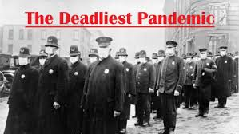
Pandemic influenza
Experts have been recommending preparedness, warning about the likelihood of future pandemic influenza outbreaks for decades.
Flu pandemic fatalities, worldwide, in the last century:
1918 – between 40 and 100 million
1957 – 2 million
1968 – 1 million
Notes:
Instructor notes:
An influenza pandemic is a much more severe type of flu outbreak. Pandemic influenza occurs when a new strain of influenza virus appears, which causes serious illness in humans and is easily spread from person to person worldwide. The disease is very contagious because people have no immunity.
Past influenza pandemics have led to high levels of illness, death, social disruption, and economic loss. In the last century there were three such pandemics. The influenza outbreaks of 1918, 1957, and 1968 killed at least forty million, two million, and one million people worldwide, respectively.
While COVID-19 is not the influenza, but its ease of transmission and seriousness of the illness can lead to the high level of death, illness, social disruption, and economic loss as previous pandemics.

Slide 26
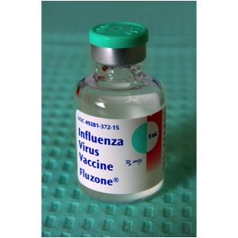
Treatment and vaccines
There is no vaccine to prevent COVID-19.
There is no specific FDA approved medication or treatment for COVID-19.
Treatment is supportive.
People who are mildly ill with COVID-19 should isolate at home during their illness.
Notes:
Instructor notes:
Medical guidelines advise people with mild illness to stay home unless it is an emergency. To reduce the risk of catching or spreading illness, stay home if you feel sick, even if your symptoms are mild. Do not go to work, school or public places, and avoid public transportation. Symptoms should be treated for fever and to prevent dehydration and body aches. Call your healthcare provider if you develop a high fever, respiratory distress, or other severe symptoms. https://www.cdc.gov/coronavirus/2019-ncov/if-you-are-sick/steps-when-sick.html
If your symptoms are severe or you feel like you need medical care, call before you go to a doctor’s office, urgent care center or emergency room. Describe your symptoms over the phone.
While a vaccine is a central part of the effort to prevent infection and illness, there is no specific antiviral treatment recommended for COVID-19. People with COVID-19 should receive supportive to help relieve symptoms. For severe cases, treatment should include oxygen supplementation and care to support vital organ functions, as needed.
Unfortunately, viruses such as the coronavirus, appear and start spreading before a vaccine is available. With a novel virus, in this case SARS-CoV-2, the population has little or no immunity to the virus.
Even when a vaccine is available, some people will not be vaccinated. Vaccines are tested to ensure that they are safe and effective for most people. However, vaccines normally can have side effects and present significant health risks for vulnerable individuals. Other people who are not considered to be at risk for serious reactions may choose not to receive the vaccine for various reasons.
There is also the possibility that the SARS-CoV-2 virus could mutate, or change over time, which could reduce the vaccine’s ability to prevent infection.
Experimental drugs and vaccines are currently being developed and tested.

Slide 27

Module 2: Assessing the Potential for Exposure to COVID-19 in the Workplace
Notes:
Instructor notes:

Slide 28
Key exposure factors in the workplace
Does the work setting require close contact with people potentially infected with the COVID-19 virus?
Do specific job duties require close, repeated or extended contact with people with known or suspected COVID-19?
Has the community spread of the virus included cases in the workplace?
Notes:
Instructor notes:
How can you determine if your risk for COVID-19 is greater where you work than in the general population? First, consider
whether the type of setting you work in requires close proximity to people potentially infected with the COVID-19 virus. Next, ask whether your specific job duties require you to have either repeated, extended or close contact with known or suspected sources of the virus.
For example, a hospital is a work setting where there will be a greater concentration of individuals who have or are suspected of having the coronavirus.
However, employees who work in the same facility have different risks depending on what part of the institution they work in and the tasks that they perform. Staff who provide bedside care to a patient with COVID-19 have a higher risk of becoming infected at work than someone working in the billing office.

Slide 29
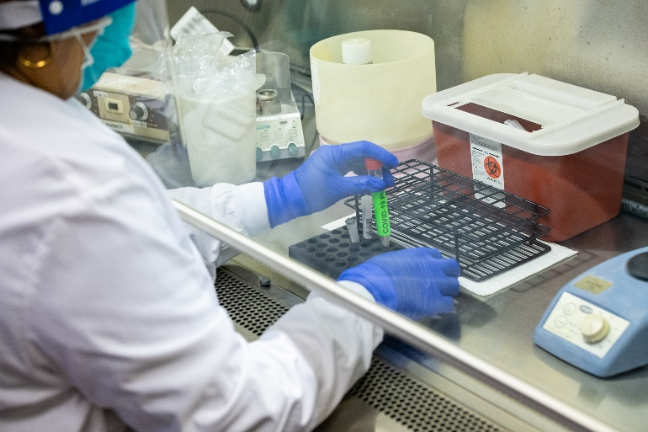
High potential for exposure
High exposure risk occupations are those working with people with known or suspected COVID-19, especially while performing aerosol generating procedures.
Examples of work settings
healthcare
laboratories
autopsy suites
Examples of job activities
bronchoscopy
sputum induction
working with specimens in laboratories
some dental procedures
some autopsy procedures
Notes:
Instructor notes:
Photo: Stanford.edu
High potential exposure occupations are those with high potential exposure to high concentrations of known or suspected sources of COVID-19 during specific medical or laboratory procedures. High concentrations of coronavirus could result from activities that generate aerosols from known or suspected sources. An aerosol is a spray or mist that is made up of solid or liquid particles.
Examples of work procedures that can produce aerosols that could contain COVID-19 or other coronavirus particles include:
Bronchoscopy
Sputum induction
Working with specimens in laboratories
Some dental procedures
Some autopsy procedures
Keep in mind that the very high risk category only applies to staff who are close to the coronavirus source.
NOTE: OSHA has published a guidance document that has four different exposure categories: very high exposure, high exposure, medium exposure, and low exposure. We have simplified the approach to two categories, high and low potential for exposure, to make it easier for participants understand the concepts and the resulting worker protection measures.
The OSHA document: https://www.osha.gov/Publications/OSHA3990.pdf

Slide 30
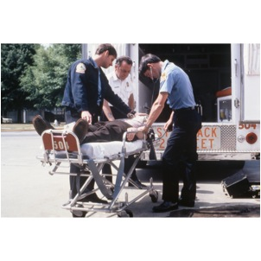
High potential for exposure
Examples of work settings
hospitals and other types of health care facilities
medical transport
correctional facilities
drug treatment centers
homeless shelters
home health care
environmental clean-up of SARS CoV-2
Examples of job activities
direct patient care
emergency medical services
housekeeping and maintenance in patient areas
Notes:
Instructor notes:
High exposure potential occupations are those with high potential for exposure to known or suspected sources of coronavirus.
Jobs that fall into this category include:
Healthcare delivery and support staff who are exposed to known or suspected COVID-10 patients. For example, doctors, nurses, and other hospital staff that must enter patients' rooms.
Medical transport of known or suspected patients in enclosed vehicles, such as emergency medical technicians.
Job duties considered at high risk for COVID-19 could take place outside of a healthcare facility. For example, staff who treat inmates with or suspected of having COVID-19 within a prison health setting would have a risk similar to those caring for patients in a hospital. If the correctional facility refers sick inmates to another facility, staff involved in transporting the prisoners would be performing a medical transport function.
High exposure potential includes environmental clean-up workers assigned to clean and disinfect buildings and other locations, equipment, and materials where known cases of COVID-19 have been present.

Slide 31
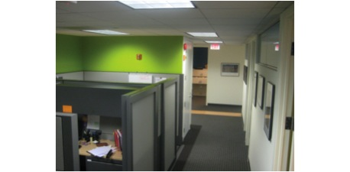
Low potential for exposure
Low potential for exposure occupations are those that do not require contact with people known to be infected nor frequent contact with the public.
Notes:
Instructor notes:
Low potential exposure occupations are those that do not require contact with people known to be infected with the coronavirus, nor frequent close contact with the public, for example office workers or construction workers. However, in communities with widespread infection, any congregate setting may be affected.

Slide 32
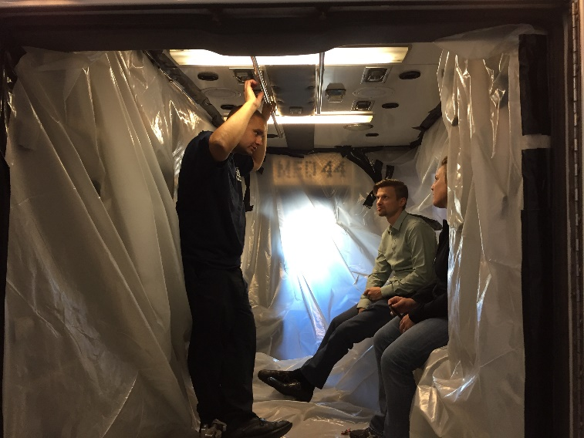
The next few slides will review key considerations for the health care and emergency services industries as well as continuity of operations and the role of public health.
Notes:
Instructor notes:
Photo by Jonathan Rosen, Omaha Fire Department

Slide 33
Healthcare settings
Refer to the CDC and state health department guidelines for protection of healthcare workers. In the current and past coronavirus outbreaks healthcare workers have had a high rate of infection. Therefore, it is especially important to ensure that procedures, equipment, and training are fully protective
https://www.cdc.gov/coronavirus/2019-ncov/hcp/index.html
The CDC site includes guidelines for infection control, EMS, home care, clinical care, evaluating persons under investigation, and more.
Notes:
Instructor notes:
Not everyone in a high exposure potential setting has the same risk of exposure to COVID-19. Workers’ performing aerosol generating procedures or cleaning and disinfecting these environments need the highest level of protection.
For example, hospital staff who perform bronchoscopy or sputum induction on known or suspected COVID-19 cases are at the highest risk. Medical staff who provide bedside care and other employees who enter rooms of patients known or suspected of being infected also have a high potential for exposure. Other employees, such as kitchen staff or those who work in the billing office have a lower risk.
For detailed guidelines refer to the CDC guidelines on the slide and relevant OSHA standards on PPE and respiratory protection.

Slide 34
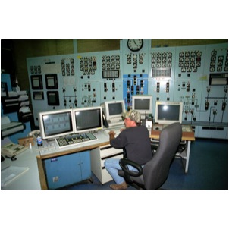
Emergency Services
Emergency services and critical infrastructure must be able to function during a national emergency.
Emergency services and critical infrastructure include:
law enforcement
Fire and EMS
hospitals
public utilities
Notes:
Instructor notes:
Critical infrastructure and key resource operations include law enforcement, emergency response, or public utility employees. It is essential to develop job and task specific protective measures for these employees. The goal is to protect these workers as well as keeping critical services functioning and avoid the potential difficulties in replacing them during a pandemic.

Slide 35

Community/Workplace Connection
When a community outbreak occurs, any workplace or event location where people gather has a high potential for exposure.
Examples of work settings
schools
sports and arts events
social services
high density of coworkers
high contact with the general public including retail
Examples of job activities
classroom instruction
aiding clients
serving customers
Notes:
Instructor notes:

Slide 36
Critical infrastructure
Keeping critical infrastructure and key resources operating is a priority!
Government Facilities
Dams
Commercial Facilities
Nuclear Power Plants
Food and Agriculture
Public Health and Healthcare
Banking and Finance
Chemical Manufacturing and Storage Facilities
Defense Industrial Base
Water
Energy
Emergency Services
Information Technology
Telecommunications
Postal and Shipping
Transportation
Notes:
Instructor notes:
The U.S. government has placed a special emphasis on supporting pandemic influenza planning for public and private sector businesses deemed to be critical industries and key resources (CI/KR). Critical infrastructure are the sectors that provide the production of essential goods and services, interconnectedness and operability, public safety, and security that contribute to a strong national defense and thriving economy. Key resources are facilities, sites, and groups of organized people whose destruction could cause large-scale injury, death, or destruction of property and/or profoundly damage our national prestige and confidence.
Additional guidance for CI/KR business is available at:
www.pandemicflu.gov/plan/pdf/CIKRpandemicInfluenzaGuide.pdf.
Commercial facilities include grocery stores, gas stations, and other essential services.

Slide 37
Continuity of Operations (COOP)
All businesses and agencies should develop a strategy to overcome potential disruptions to operations for:
maintaining critical utilities and infrastructure;
rostering personnel with authority and knowledge of functions;
policies that enable employees to work remotely;
communications with employees and customers, including during disruptions to usual services;
stockpiling supplies or developing multiple suppliers in the event of a supply chain disruption;
Notes:
Instructor notes:
FEMA Brochure: What is Continuity of Operations?
https://www.fema.gov/pdf/about/org/ncp/coop_brochure.pdf
Disaster Management checklist: https://www.paho.org/disasters/index.php?option=com_docman&view=download&category_slug=tools&alias=543-pandinflu-leadershipduring-tool-16&Itemid=1179&lang=en
Cross training is another important step in COOP.

Slide 38
Role of public health officials
Case identification and containment.
Communication and education.
Contact tracing is when public health officers investigate contacts of a person who is infected to determine if they should be quarantined to prevent the spread of the virus.
Mitigation may include restrictions on public events and gatherings, transportation, and other activities.
Promote social distancing, staying out of places where people meet or gather, avoiding local public transportation if sick and maintaining distance (approximately 6 feet or 2 meters) from others.
Notes:
Instructor notes:
The purpose of social distancing is to slow the spread of SARS CoV-2. A good factsheet on that topic is: http://www.cidrap.umn.edu/sites/default/files/public/php/185/185_factsheet_social_distancing.pdf
The public health officials are empowered to enforce the public health laws and regulations which vary state by state. Among their duties are education, inspection, quarantine, and enforcement.

Slide 39
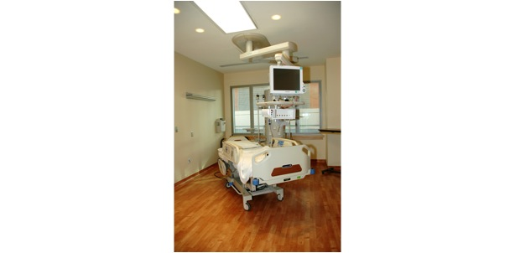
Module 3: Methods to Prevent COVID-19 in the Workplace
Notes:
Instructor notes:

Slide 40

Key steps for managing epidemics in the workplace
Preparing for the threat.
Implementing preventive measures.
Implementing the continuity of operations plan.
Managing business recovery post-epidemic.
Notes:
Instructor notes:
CDC, Get Your Workplace Ready for Pandemic Flu, 2017, https://www.cdc.gov/nonpharmaceutical-interventions/pdf/gr-pan-flu-work-set.pdf
OSHA, Guidance on Preparing for an Influenza Pandemic, OSHA 3327-02N 2007, https://www.osha.gov/Publications/OSHA3327pandemic.pdf
OSHA, Guidance on Preparing Workplaces for COVID-19, OSHA 3990-03 2020, https://www.osha.gov/Publications/OSHA3990.pdf
Although details on preparedness and response are beyond this brief awareness training, the sites above have excellent guidance on these subjects.

Slide 41
Community spread can impact any workplace
Mitigation may include shutting down events and worksites where people gather.
For example, the National Basketball Association suspended its season on March 11, 2020.
Many universities and colleges have ended onsite classes and have moved to online learning.
Workers at stadiums, arts centers, and other places where people gather may be impacted.
Notes:
Instructor notes:
Note that the information on this slide will change as the dynamics of the pandemic response change. It will be important to update it with the latest information regarding community response. Reliable sources include CDC, NIEHS WTP, OSHA, and local and state health departments.

Slide 42
Consider the impact on workers
Will a worker be paid if their workplace shuts down or they are quarantined?
What can be done for workers who are sick but have no paid sick leave?
How can workers cope with the impact if their child’s school is shut down or their child is placed in quarantine?
What can be done for low wage and immigrant workers who have no access to healthcare?
Other impacts?
Notes:
Instructor notes:
Each state has its own workers’ compensation law. This may be relevant if a worker is exposed to SARS CoV-2 and made ill on-the-job.

Slide 43
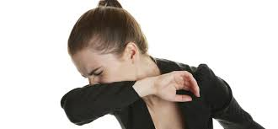
Basic hygiene and social distancing
Stay home when sick.
Wash hands or use sanitizer frequently and after coughing, sneezing, blowing nose, and using the restroom.
Avoid touching your nose, mouth, & eyes.
Cover coughs & sneezes with tissues or do it in your sleeve.
Dispose of tissues in no-touch bins.
Avoid close contact with coworkers and customers.
Avoid shaking hands/wash hands after physical contact with others.
Notes:
Instructor notes:
Regardless of exposure potential, there are several steps that everyone can take to lower the chances of becoming sick or spreading COVID-19 at work.
Stay home if you are sick.
Wash your hands frequently with soap and water for 20 seconds or use hand sanitizer if soap and water are not available.
Avoid touching your nose, mouth and eyes.
Cover your coughs and sneezes with a tissue, or cough and sneeze into your upper sleeve.
Dispose of tissues in no-touch trash receptacles.
Wash your hands or use a hand sanitizer after coughing, sneezing, or blowing your nose.
Avoid close contact with coworkers and customers.
Avoid shaking hands and always wash your hands after physical contact with others.

Slide 44
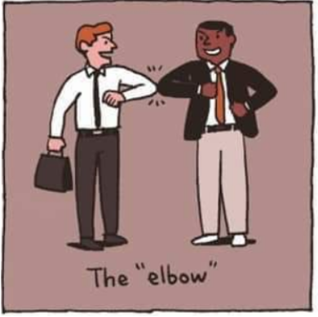

STOP shaking hands!
Image courtesy of NUS University of Singapore, Yong Loo Lin School of Medicine
Notes:
Instructor notes:
Alternatives to shaking hands include the elbow bump, hat tip, etc.
Image courtesy of NUS University of Singapore, Yong Loo Lin School of Medicine

Slide 45
Key elements: COVID-19 workplace plan
Management leadership and employee participation
Hazard identification and assessment
Hazard prevention and control
Education and training
System evaluation and improvement
Family preparedness
Plan for a pandemic with “increased severity”
CDC recommends planning for current severity and “increasing severity”
Notes:
Instructor notes:
Planning and preparation for COVID-19 should be integrated into existing safety and health systems and emergency plans. Elements of an effective program include but are not limited to those listed above.
Maintain flexibility so the COVID-19 plan can be modified in the event of a pandemic with “increased severity.”
System evaluation and improvement refers to organizational policies and procedures relevant to the COVID-19 workplace plan. For example, during an outbreak when a worker is absent due to respiratory illness, the employer’s absentee policy should be relaxed by not requiring a doctor’s note. The CDC has made this recommendation because they are advising people with low level symptoms NOT to go to the hospital emergency room unless they have severe symptoms.
CDC Interim Guidance for Businesses and Employers: https://www.cdc.gov/coronavirus/2019-ncov/community/guidance-business-response.html?CDC_AA_refVal=https%3A%2F%2Fwww.cdc.gov%2Fcoronavirus%2F2019-ncov%2Fspecific-groups%2Fguidance-business-response.html
Family preparedness is instrumental to ensuring that a healthy staff is available and prepared to work during a pandemic. Organizations should try to identify and assess how the impact of school/daycare/ adult care closures and other employee needs may impact the availability of employees during a pandemic.
National Academy of Sciences, Engineering and Medicine: A Guide for Public Transportation Pandemic Planning and Response
http://nap.edu/22414

Slide 46
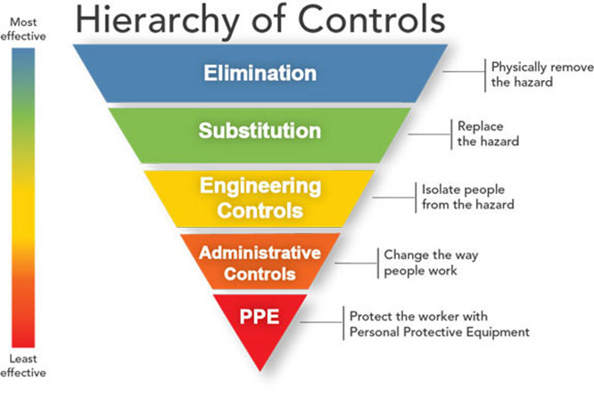
Protecting workers
Start with the most effective method to protect workers.
Notes:
Instructor notes:
As with most any hazard, there are a variety of steps that can reduce or in some cases even eliminate workers’ exposure. A basic principle of workplace safety is to use a combination of strategies to protect workers, starting with the most effective. This approach of moving from most effective to least effective protective measures is called the ‘hierarchy of controls.’
The order of controls, from most effective to least effective is:
Elimination
Substitution
Engineering controls
Administrative Controls & Work practices
Personal protective equipment
Source: NIOSH/CDC https://www.cdc.gov/niosh/topics/hierarchy/default.html
This webpage also provides a more thorough definition of each type of control measure.

Slide 47
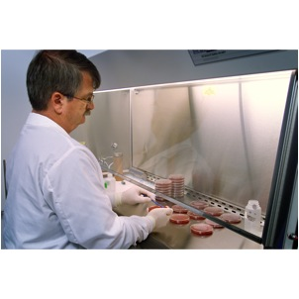
Engineering controls
Ventilation
Drive through service
Plastic shields and other barriers
Sneeze guards
Notes:
Instructor notes:
Engineering controls involve making changes to the work environment to reduce work-related hazards. These types of controls are preferred over others because they make permanent changes that reduce exposure to hazards and do not rely on worker or customer behavior. By reducing a hazard in the workplace, engineering controls are not only the most effective, but can also be the most cost-effective solutions for employers to implement.
Examples of engineering controls include:
Using specialized ventilation to remove hazards from the air.
Installing physical barriers, such as clear plastic sneeze guards.
Installing a drive-through window for customer service.

Slide 48
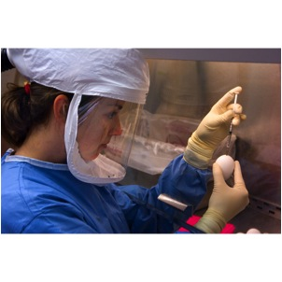
Engineering controls for high exposure potential jobs
Engineering controls for high-risk workers include:
Negative pressure isolation rooms
Biological safety cabinets HEPA filtration
UV irradiation systems
Notes:
Instructor notes:
Engineering controls protect workers by removing or reducing COVID-19 from the work environment. Negative pressure ventilation is an engineering control that is used staff conduct procedures that create aerosols or enter patient rooms of known or suspected COVID-19 cases.
In the photograph above, a microbiologist is conducting an experiment inside a biological safety cabinet (BSC). The airflow within the BSC helps prevent any airborne virus from escaping the confines of the cabinet. As added protection, she is wearing a powered air purifying respirator (PAPR).

Slide 49
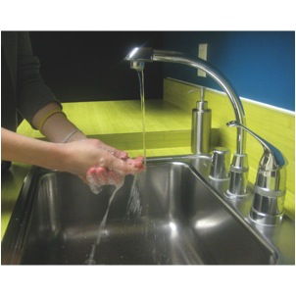
Administrative controls and work practices to reduce exposure
Enable sick workers to stay home
Establish work from home policy
Minimizing contact among workers and clients
Discontinue non-essential travel
Limiting the number of staff present for high potential exposure tasks
Training
Notes:
Instructor notes:
Administrative controls include work practices and procedures to reduce the length, frequency or intensity of exposure to a hazard. Employers should:
Provide resources and a work environment that promotes personal hygiene. For example, supply tissues, no-touch trash cans, hand soap, hand sanitizer, disinfectants and disposable towels for workers to clean their work surfaces.
Develop procedures to minimize contacts between workers and between workers and patients, clients or customers.
Limit the number of staff present for high exposure tasks such as aerosol generating procedures or entering patient room.
Provide workers with up-to-date education and training on coronavirus risk factors, and methods to prevent exposure.

Slide 50
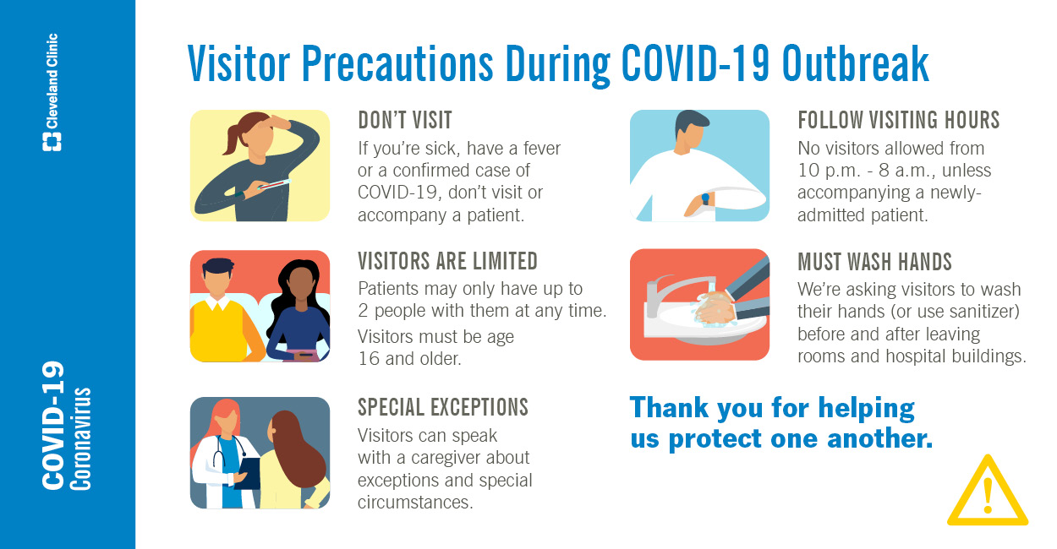
Additional administrative controls
Soft barriers include use of tables, ropes, signs, and floor markings to maintain social distancing.
Notes:
Instructor notes:

Slide 51

Adjust policies to reduce exposures
Policies that can help to reduce exposure to COVID-19 include:
Encouraging workers who are ill to stay home without fear of reprisals or loss of pay or benefits
Using email, phone, teleconferences instead of face-to-face contact
Notes:
Instructor notes:
Adjustments in workplace policies can also reduce exposures.
Encouraging ill workers to stay at home without fear of any reprisals.
Discontinuing nonessential travel to locations having high prevalence of illness.
Using e-mail, websites and teleconferences to minimizing face-to-face contact between workers. Where possible, encourage flexible work arrangements such as telecommuting or flexible work hours to reduce the number of workers who must be at the work site at one time or in one specific location.
Relying on home delivery of goods and services to reduce the number of clients or customers who must visit your workplace.
Developing emergency communications plans. Maintain a forum for answering workers' concerns and develop Internet-based communications, if feasible.
Provide education and training materials in an easy to understand format and in the appropriate language and literacy level for all employees.

Slide 52

OSHA PPE standard
Where applicable, the OSHA PPE standard requires employers to:
Conduct an assessment for PPE
Provide PPE at no cost, appropriate to the hazard
Train employees on how to don (put on) and doff (take off) PPE
Train workers to maintain, store, and replace PPE
Provide medical evaluation and fit testing
https://www.osha.gov/pls/oshaweb/owadisp.show_document?p_id=9777&p_table=STANDARDS
Notes:
Instructor notes:
Workers and union representatives have a right to obtain a copy of the PPE assessment. It is a best practice when labor and management work together to conduct the PPE hazard assessments.
If you would like to learn more about the selection of PPE for co-workers who have potential occupational exposure to SARS CoV-2, take a look at the assessment.

Slide 53
Decontamination
Employers should develop site specific decontamination procedures.
Depending on the workplace, decontamination may require consultation with the health department or use of a consultant specializing in environmental cleanup.
Use of an EPA registered disinfectant effective is recommended.
Worker and building occupant protection is essential when cleaning and disinfecting contaminated surfaces to protect against the virus and adverse effects of the disinfectant.
EPA List: https://www.epa.gov/pesticide-registration/list-n-disinfectants-use-against-sars-cov-2
Notes:
Instructor notes:
The CDC guidelines for healthcare include disinfecting immediately any visibly contaminated PPE surfaces, equipment, or patient care area surfaces using an EPA-registered disinfectant wipe. They also recommend performing regular cleaning and disinfection of patient care area surfaces, even absent visible contamination. They state that this should be performed only by nurses or physicians as part of patient care activities in order to limit the number of additional healthcare workers who enter the room.
Decontamination procedures are specific to the industry, job task, and work site. Decontamination is critical because workers can become contaminated with infectious material while taking off PPE and respirators.
Use Products with Emerging Viral Pathogens AND Human Coronavirus claims for use against SARS-CoV-2. Although there is little info on the effectiveness of disinfectants on SARS Coronavirus 2; however, disinfectants effective against other coronaviruses should be effective for SARS Coronavirus 2 so use the appropriate EPA-registered disinfectants. See: https://www.epa.gov/pesticide-registration/list-n-disinfectants-use-against-sars-cov-2
CDC guidelines for household settings: https://www.cdc.gov/coronavirus/2019-ncov/community/home/cleaning-disinfection.html#routine-cleaning
Cleaning refers to the removal of germs, dirt, and impurities from surfaces. Cleaning does not kill germs, but by removing them, it lowers their numbers and the risk of spreading infection.
Disinfecting refers to using chemicals to kill germs on surfaces. This process does not necessarily clean dirty surfaces or remove germs, but by killing germs on a surface after cleaning, it can further lower the risk of spreading infection.

Slide 54
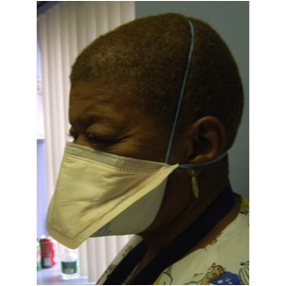
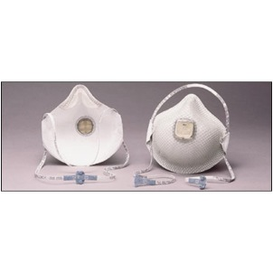
Respirators
Respirators are needed when there is a potential for aerosol transmission.
An N95 respirator is the minimum level of protection to prevent inhaling coronavirus.
Notes:
Instructor notes:
Respirators are used to prevent breathing in hazards that are in the air. Respirators protect the wearer by either filtering the air before it is inhaled by the worker, or by supplying air from a safe source. Most respirators that protect the worker by filtering the air are designed to fit tightly against the face, and thereby provide a seal between the respirator's edge and the face. When there is a proper seal, the air the worker breathes passes through the respirator’s filter, which captures contaminants. If there is not a tight seal, the air passes through the gaps between the face and the respirator and contaminants are not filtered from the air that the worker breathes.
The National Institute for Occupational Safety and Health, part of the CDC, certifies air purifying respirators, sometimes called particulate respirators, in the following categories based on the resistance to oil, which can reduce efficiency:
N95, N99, N100 - Filters at least 95%, 99%, 99.97% of airborne particles. Not resistant to oil.
R95, R99, R100 - Filters at least 95%, 99%, 99.97% of airborne particles. Somewhat resistant to oil.
P95, P99, P100 - Filters at least 95%, 99%, 99.97% of airborne particles. Strongly resistant to oil.
NIOSH approved respirators will be marked “NIOSH” and the N, R, P categories.

Slide 55
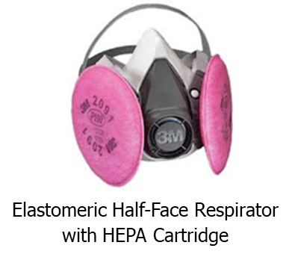
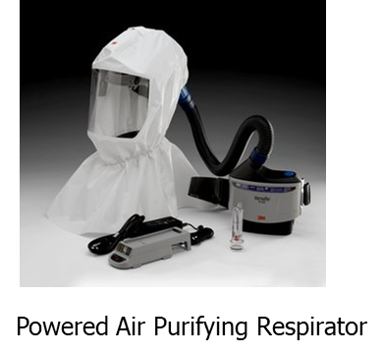
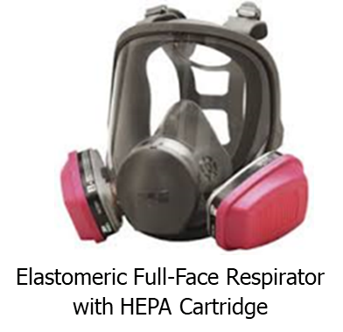
Respirators (continued)
Advantages of reusable respirators:
Durability
Stand up to repeated cleaning & disinfection
Maintain fit over time
Cost savings
Powered air-purifying respirator (PAPR)
Half or full-face elastomeric respirators
Notes:
Instructor notes:
There are many types of respirators that are designed to be reused and that provide a number of advantages over disposable respirators against airborne hazards. A half-face or full-face elastomeric air-purifying respirator provides a tighter fit. A full face elastomeric has a higher level of protection than a disposable or half face respirator.
Powered air purifying respirators can be either tight-fitting or loose fitting depending on the design. In either case, air is drawn in by a pump and travels through a hose. The air passes through a filter before being blown across the worker’s face.

Slide 56
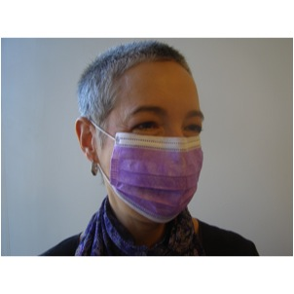
Respirators (continued)
Surgical masks are not respirators!
Surgical masks do not:
Fit tightly against the skin to form a seal
Filter tiny particles, such as viruses or bacteria that are in the air
Notes:
Instructor notes:
Surgical masks are not respirators. Surgical masks are not designed or certified to prevent the wearer from inhaling small airborne hazards, such as viruses, or virus particles. Surgical or procedure masks do not form a tight seal against the user's face. Therefore, when the wearer breathes in, much of the potentially infectious air passes through gaps between the face and the surgical mask. Second, many surgical masks are not made of a material that can filter microscopic particles. Only surgical masks that are cleared by the U.S. Food and Drug Administration and legally marketed in the United States have been tested for their ability to resist blood and body fluids can be used.
Surgical masks are used as a physical barrier to protect employees from hazards such as splashes of large droplets of blood or body fluids. Surgical masks also prevent contamination by trapping large particles of body fluids that may contain bacteria or viruses when they are expelled when the wearer coughs and sneezes.
Surgical/procedure masks are used for several different purposes, including:
Being placed on sick people to limit the spread of infectious respiratory secretions to others.
Worn by healthcare providers to prevent accidental contamination of patients' wounds by the organisms normally present in mucus and saliva
Worn by employees to protect themselves from splashes or sprays of blood or body fluids; they may also have the effect of keeping contaminated fingers/hands away from the mouth and nose.
Bandannas, neck gators, etc. are not respirators - their use DOES NOT afford any protection to inhalation of airborne droplets containing the virus. However using one of these items may reduce the frequency that people touch their face.

Slide 57

Respiratory protection standard
Respiratory programs must comply with all elements of OSHA Standard 29 CFR 1910.134
Written program
Selection hazard to match hazard
Medically fit to wear
Fit testing
Ensure proper use of respirators
Respirator maintenance
Labeling/color coding filters
Employee training
Program evaluation
Recordkeeping
Notes:
Instructor notes:
Respirators must be used according to OSHA’s Standard 1910.134. OSHA requires that employers:
Have a written program with worksite specific procedures.
Select respirators based on the hazards in the workplace.
Provide a medical evaluation to determine the employee’s ability to wear a respirator.
Fit test respirators that require a tight seal between the worker’s face and the respirator.
Establish and implement procedures for the proper use of respirators.
Provide for cleaning, storage, and repair of respirators.
Ensure that all filters, cartridges and canisters are labeled and color coded.
Train workers at least once a year on the proper use and limitations of respirators.
Conduct an evaluation to make sure the respiratory program is being properly implemented.
Keep records on medical evaluations, fit testing and other aspects of the program.
Due to the shortage of respirators, NIOSH has issued a memo regarding extended and reuse of N95 air purifying respirators. https://www.cdc.gov/niosh/topics/hcwcontrols/recommendedguidanceextuse.html

Slide 58
Healthcare facility identification and isolation The most important steps to prevent spread of COVID-19
Procedures for rapid identification and isolation of suspect COVID-19 cases
Community and hospital procedures to ensure symptomatic people are not in public places, waiting rooms, reception areas, emergency departments, or other common areas
Collect a travel history for patients presenting with fever, cough, or shortness of breath
Immediately isolate – using standard, contact and droplet precautions for suspect or confirmed cases
Notes:
Instructor notes:
Early identification and isolation of suspect cases is the most important measures to contain the spread of coronavirus. Hospitals play a key role in the rapid ID of COVID-19 cases. Other industries can also be alert to these factors. Coordination between hospitals and public health authorities is critical.
https://www.cdc.gov/coronavirus/2019-ncov/healthcare-facilities/index.html
https://www.cdc.gov/coronavirus/2019-nCoV/hcp/index.html
Cal/OSHA Interim Guidance on Coronavirus for Health Care Facilities: Efficient Use of Respirator Supplies. This document provides advice on use of expired respirators in healthcare facilities during the supply shortage. https://www.dir.ca.gov/dosh/documents/Use-of-Respirator-Supplies.pdf

Slide 59
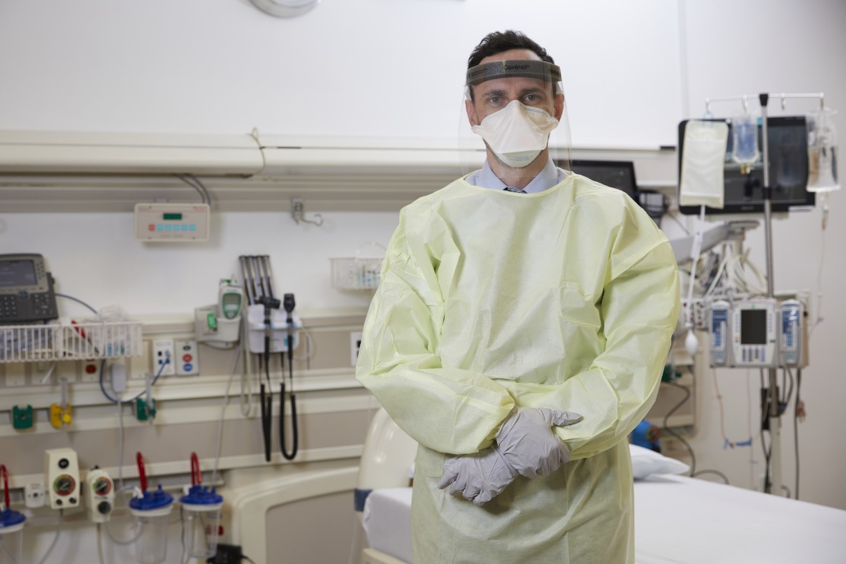
PPE for jobs with high potential exposure
Face/eye protection
Gloves
Gowns
Respirators
At least N95
PAPR or full or half face elastomeric for greater protection
NOTE: there is a worldwide shortage of PPE!
Notes:
Instructor notes:
Personal protective equipment protects against exposures to COVID-19 that cannot be eliminated or reduced by other measures. Workers need to use gloves, gowns, and face/eye protection.
Respirators approved by the National Institute for Occupational Safety and Health (NIOSH) are needed to prevent inhaling aerosolized SARS CoV-2 particles. At a minimum, workers need to wear an N95 respirator. A higher level of respiratory protection, such as a powered air-purifying respirator or PAPR, should be worn during high hazard procedures that generate aerosols.
Respirators should not be used after the expiration date. Maintaining equipment that is current should be part of the practices and procedures in the workplace. NOTE: some of the respirators in the national stockpile that are being released for use in the national emergency are expired. NIOSH has tested batches and found most of them to be still useable. Also Cal/OSHA has issued guidance as has NIOSH on prioritizing use of respirators during the shortage. See the links on slides 58 and 59.
NOTE: OSHA has issued Temporary Enforcement Guidance - Healthcare Respiratory Protection Annual Fit-Testing for N95 Filtering Facepieces During the COVID-19 Outbreak in recognition of the shortage of N95s: https://www.osha.gov/memos/2020-03-14/temporary-enforcement-guidance-healthcare-respiratory-protection-annual-fit
Due to PPE shortage, people using PPE in training should be careful to conserve the equipment for use after training. NIOSH and OSHA have published guidance that says In order to conserve the supply of N95 respirators, healthcare facilities should understand which of their healthcare personnel do and do not need to be in a respiratory protection program and thus medically evaluated, trained, and fit tested. If training and fit testing are conducted during two separate steps, it is possible to allow limited re-use of N95 respirators used by individual workers during both steps. https://www.cdc.gov/coronavirus/2019-ncov/hcp/respirators-strategy/conventional-capacity-strategies.html

Slide 60
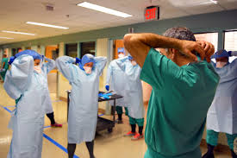
Training and drills
Must be hands-on and frequent
Should not be primarily computer based or lecture
Must include an opportunity to drill the actual process of donning and doffing PPE and respirators
Should include a trained observer and cover site specific decontamination procedures.
Notes:
Instructor notes:
Photo: courtesy of defense.gov
For awareness level training, distance learning is going to be more prevalent in this national emergency due to the inability for gatherings of people in classrooms and travel of instructors. However, for donning and doffing of PPE and respirators, hands on training is necessary. Many studies have documented that improper donning and doffing have caused workers to be contaminated.
Reference: JAMA Intern Med. 2015;175(12):1904-1910. doi:10.1001/jamainternmed.2015.4535
Published online October 12, 2015.
CONCLUSIONS AND RELEVANCE Contamination of the skin and clothing of health care personnel occurs frequently during removal of contaminated gloves or gowns. Educational interventions that include practice with immediate visual feedback on skin and clothing contamination can significantly reduce the risk of contamination during removal of PPE.

Slide 61
Prevention in all work settings
Wash hands after removing gloves or when soiled.
Keep common surfaces such as telephones, keyboards clean.
Avoid sharing equipment if possible.
Minimize group meetings by using phone, email, and avoid close contact when meetings are necessary.
Consider telework.
Limit unnecessary visitors to the workplace.
Maintain your physical and emotional health with rest, diet, exercise and relaxation.
Notes:
Instructor notes:
In general, sharing of PPE is not advised as it can spread contamination and compromise the fit and effectiveness of the equipment.
https://www.fda.gov/medical-devices/personal-protective-equipment-infection-control/questions-about-personal-protective-equipment-ppe

Slide 62
Protection of essential workers
Fire, police, grocery stores, gas stations, utilities, communications, and healthcare facilities are examples of essential industries and operations that remain open during a pandemic shutdown.
A site and job task specific risk assessment should be conducted to document the necessary protective measures.
Social distancing measures may include use of barriers, signs, modifying work procedures that require close human interaction. Other steps may include increased cleaning and disinfection, use of PPE and respirators, and training.
Notes:
Instructor notes:
CDC, Get Your Workplace Ready for Pandemic Flu, 2017, https://www.cdc.gov/nonpharmaceutical-interventions/pdf/gr-pan-flu-work-set.pdf
OSHA, Guidance on Preparing for an Influenza Pandemic, OSHA 3327-02N 2007, https://www.osha.gov/Publications/OSHA3327pandemic.pdf
OSHA, Guidance on Preparing Workplaces for COVID-19, OSHA 3990-03 2020, https://www.osha.gov/Publications/OSHA3990.pdf

Slide 63
OSHA Hazard Communication standard
The hazard communication standard, 29 CFR 1910.1200, establishes a worker’s right to know about chemicals in the workplace
Employers are required to develop:
List of all hazardous chemicals in the workplace
Labels on containers
Chemical information (safety data sheets)
Training
Written program and worker access to information
These rights may be relevant to the cleaning and disinfecting chemicals
Notes:
Instructor notes:
Workers who use chemicals for cleaning and disinfection must understand the hazards of using these substances. OSHA’s Hazard Communication Standard, 1910.1200, requires employers to:
Maintain a list of all hazardous chemicals in the workplace.
Ensure all chemical containers are labeled.
Obtain and make available chemical information sheets (material safety data sheets) for all hazardous chemicals in the workplace.
Provide training to workers on hazardous chemicals, and
Develop and implement a written program on how to inform workers of hazardous chemicals in each of their workplaces.

Slide 64
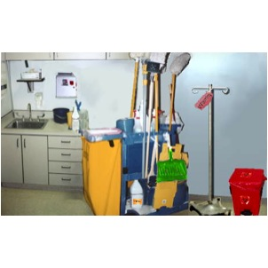
Portable containers
Portable containers must be labeled
Exception: portable containers do not have to be labeled if only the worker who transfers the chemical uses it during that shift
Notes:
Instructor notes:
Portable containers usually have to be labeled. Employers are not required to label portable containers when a worker transfers a chemical from a labeled container as long as only that employee will use the portable container during his or her shift.

Slide 65
Cal OSHA Aerosol Transmissible Disease (ATD) Standard
http://www.dir.ca.gov/Title8/5199.html
Enforceable in California, it applies to many types of health care settings, police services, correctional facilities, drug rehab centers, homeless shelters, and other settings.
Requires different types of engineering controls, work practices and administrative controls, and PPE depending on the level of potential exposure.
It is a useful reference for all states.
Notes:
Instructor notes:
California’s State OSHA program issued an Aerosol Transmission Disease Standard (ATD) in the summer of 2009. While it only applies to certain workplaces in California, it is a very good model of precautions that should be taken elsewhere.
California’s ATD Standard applies to health care settings such as hospitals, skilled nursing facilities, clinics, medical offices, and other outpatient medical facilities, long term health care facilities and hospices, and medical outreach services. It also covers paramedic and emergency medical services including these services when provided by firefighters and other emergency responders and medical transport. The standard also applies to facilities that are designated to receive persons arriving from the scene of an uncontrolled release of hazardous substances, police services, correctional facilities, drug rehabilitation centers, homeless shelters and other settings.
The standard requires a variety of engineering controls, work practices and administrative controls, and personal protective equipment depending on the nature of the exposure risk.

Slide 66
Mental health & stress
As the number of cases of COVID-19 increase, so does the associated anxiety and stress. Consider the following steps:
Use your smart phone to stay connected to family and friends. Shift from texting to voice or video calling to feel more connected.
Keep comfortable. Do more of the things you enjoy doing at home.
Practice stress relief whenever you feel anxiety building – do some deep breathing, exercise, read, dig in the garden, whatever works for you.
Avoid unhealthy behavior such as excess drinking – that will just increase your anxiety afterwards.
Keep looking forward. Make some plans for six months down the road.
Notes:
Instructor notes:
See the NIEHS Disaster Worker Resiliency Training for additional training opportunities. https://tools.niehs.nih.gov/wetp/index.cfm?id=2528
These materials prepare workers to recognize and understand their reactions to stress and traumatic events. The four-hour interactive program focuses on self-care strategies and reviews positive and negative reactions to trauma and stress.
Self-care includes:
Adequate sleep. Seven to 8 hours according to federal guidelines.
Healthy eating. Avoid caffeine, sugar, etc.
Exercise or other forms of movement can help reduce the stress reaction.
Relaxation. Give yourself a break from thinking about the crisis and work.
It is very important for workers to be aware of job stressors and seek professional assistance when needed.

Slide 67
PSD Guide
The PSD Training Module trains workers how to use existing resources to research and evaluate the characteristics of infectious disease hazards and also to understand the recommended methods for controlling them.
Notes:
Instructor notes:
Welcome to the Pathogen Safety Data Guide Training Module that is being provided to you by (name of organization). This program was developed by the National Institute of Environmental Health Sciences Worker Training Program and we acknowledge their support.
In this program we will be working in small groups and also doing individual activities. You will be using the Pathogen Safety Data Guide, which we will refer to as the Guide, throughout the program as well as the worksheet. You will write directly onto the worksheet. The material that is on the PowerPoint slides is in the Guide.
In the back of the Guide is a risk assessment checklist, and a list of references. We have also produced a Glossary so that you may look up unfamiliar terminology. We have set up a webpage so that you can easily access these materials for downloading and printing.
We will begin by reviewing the course agenda and objectives.“
NOTE: This material is in the public domain and users are encourage to adapt and modify the material to the needs of their organization and training populations.

Slide 68
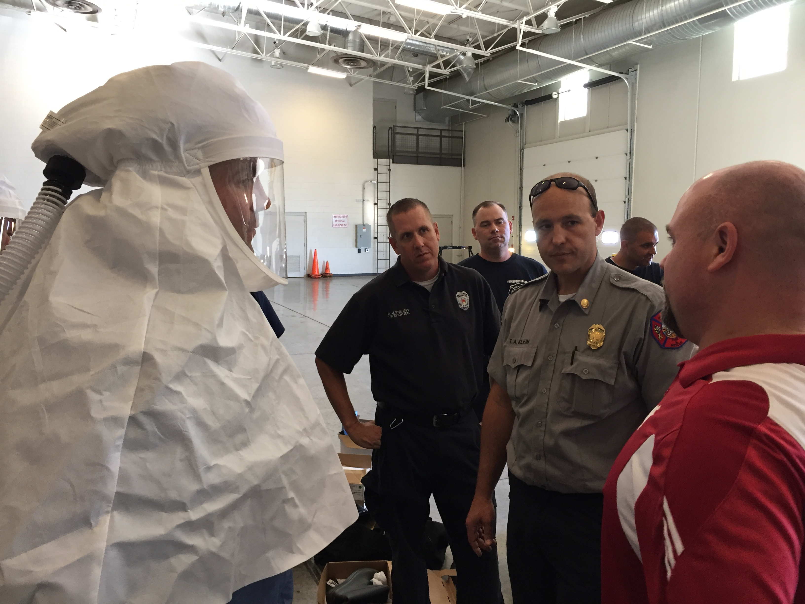
Program design
Interactive
Adult training techniques
Designed for workers & community
All hazards approach
Structured training materials
Notes:
Instructor notes:

Slide 69
Objectives
Upon taking this module, participants will be able to:
Access and use existing resources for pathogen safety data.
Look up key terminology used in pathogen safety data resources.
Explain the use of pathogen safety data resources in risk assessment and infection prevention and control activities.
Notes:
Instructor notes:
The 3 overall objectives of the PSD training module are listed on the slide.
Objectives can be customized to suit training goals and target population.
Review the training agenda with participants so they will know the organization of the module and the activities.

Slide 70
PSD guide training materials
PPT presentation
Participant worksheet
The PSD Guide
A glossary
Four case studies that can be used as alternative to activities
An instructor guide
Download the PSD materials: https://tools.niehs.nih.gov/wetp/index.cfm?id=2554
Notes:
Instructor notes:

Slide 71
Acronyms
CDC Centers for Disease Control and Prevention
EPA U.S. Environmental Protection Agency
HEPA high-efficiency particulate air
HHS U.S. Department of Health and Human Services
JCAHO Joint Commission on Accreditation of Healthcare Organizations
LRN Laboratory Response Network
NIOSH National Institute for Occupational Safety and Health
OSH Act Occupational Safety and Health Act of 1970
OSHA Occupational Safety and Health Administration
PAPR Powered air-purifying respirator
PPE Personal protective equipment
SNS Strategic National Stockpile
WHO World Health Organization
Notes:
Instructor notes:

Slide 72
For more information
Centers for Disease Control and Prevention (CDC)
http://www.cdc.gov
Occupational Safety and Health Administration (OSHA)
http://www.osha.gov
World Health Organization
http://www.who.int/en/
National Institute for Occupational Safety and Health (NIOSH)
http://www.cdc.gov/NIOSH/
NIEHS Worker Training Program
https://tools.niehs.nih.gov/wetp/index.cfm?id=2554
Notes:
Instructor notes:

Slide 73
Why this training tool was created
This training tool was created by the NIEHS National Clearinghouse for Worker Safety and Health Training under a contract (HHSN273201500075U) from the National Institute of Environmental Health Sciences Worker Training Program (WTP).
WTP has trained more than two million emergency responders and hazardous waste workers since 1987 to do their jobs safely. WTP is a part of the Department of Health and Human Services, which is a cooperating agency under the Worker Safety and Health Support Annex of the National Response Plan. As part of the coordinated effort, the National Clearinghouse worked with NIEHS, WTP to create this orientation briefing for those who may be exposed to COVID-19 (coronavirus).
Notes:
Instructor notes:
For more information, contact the National Clearinghouse for Worker Safety and Health Training at http://tools.niehs.nih.gov/wetp/, 202-331-7733, or info@wetp.org.

